Slide 1


Final Capstone Project Management

Slide 2

IN THE BEGINNING

Slide 3
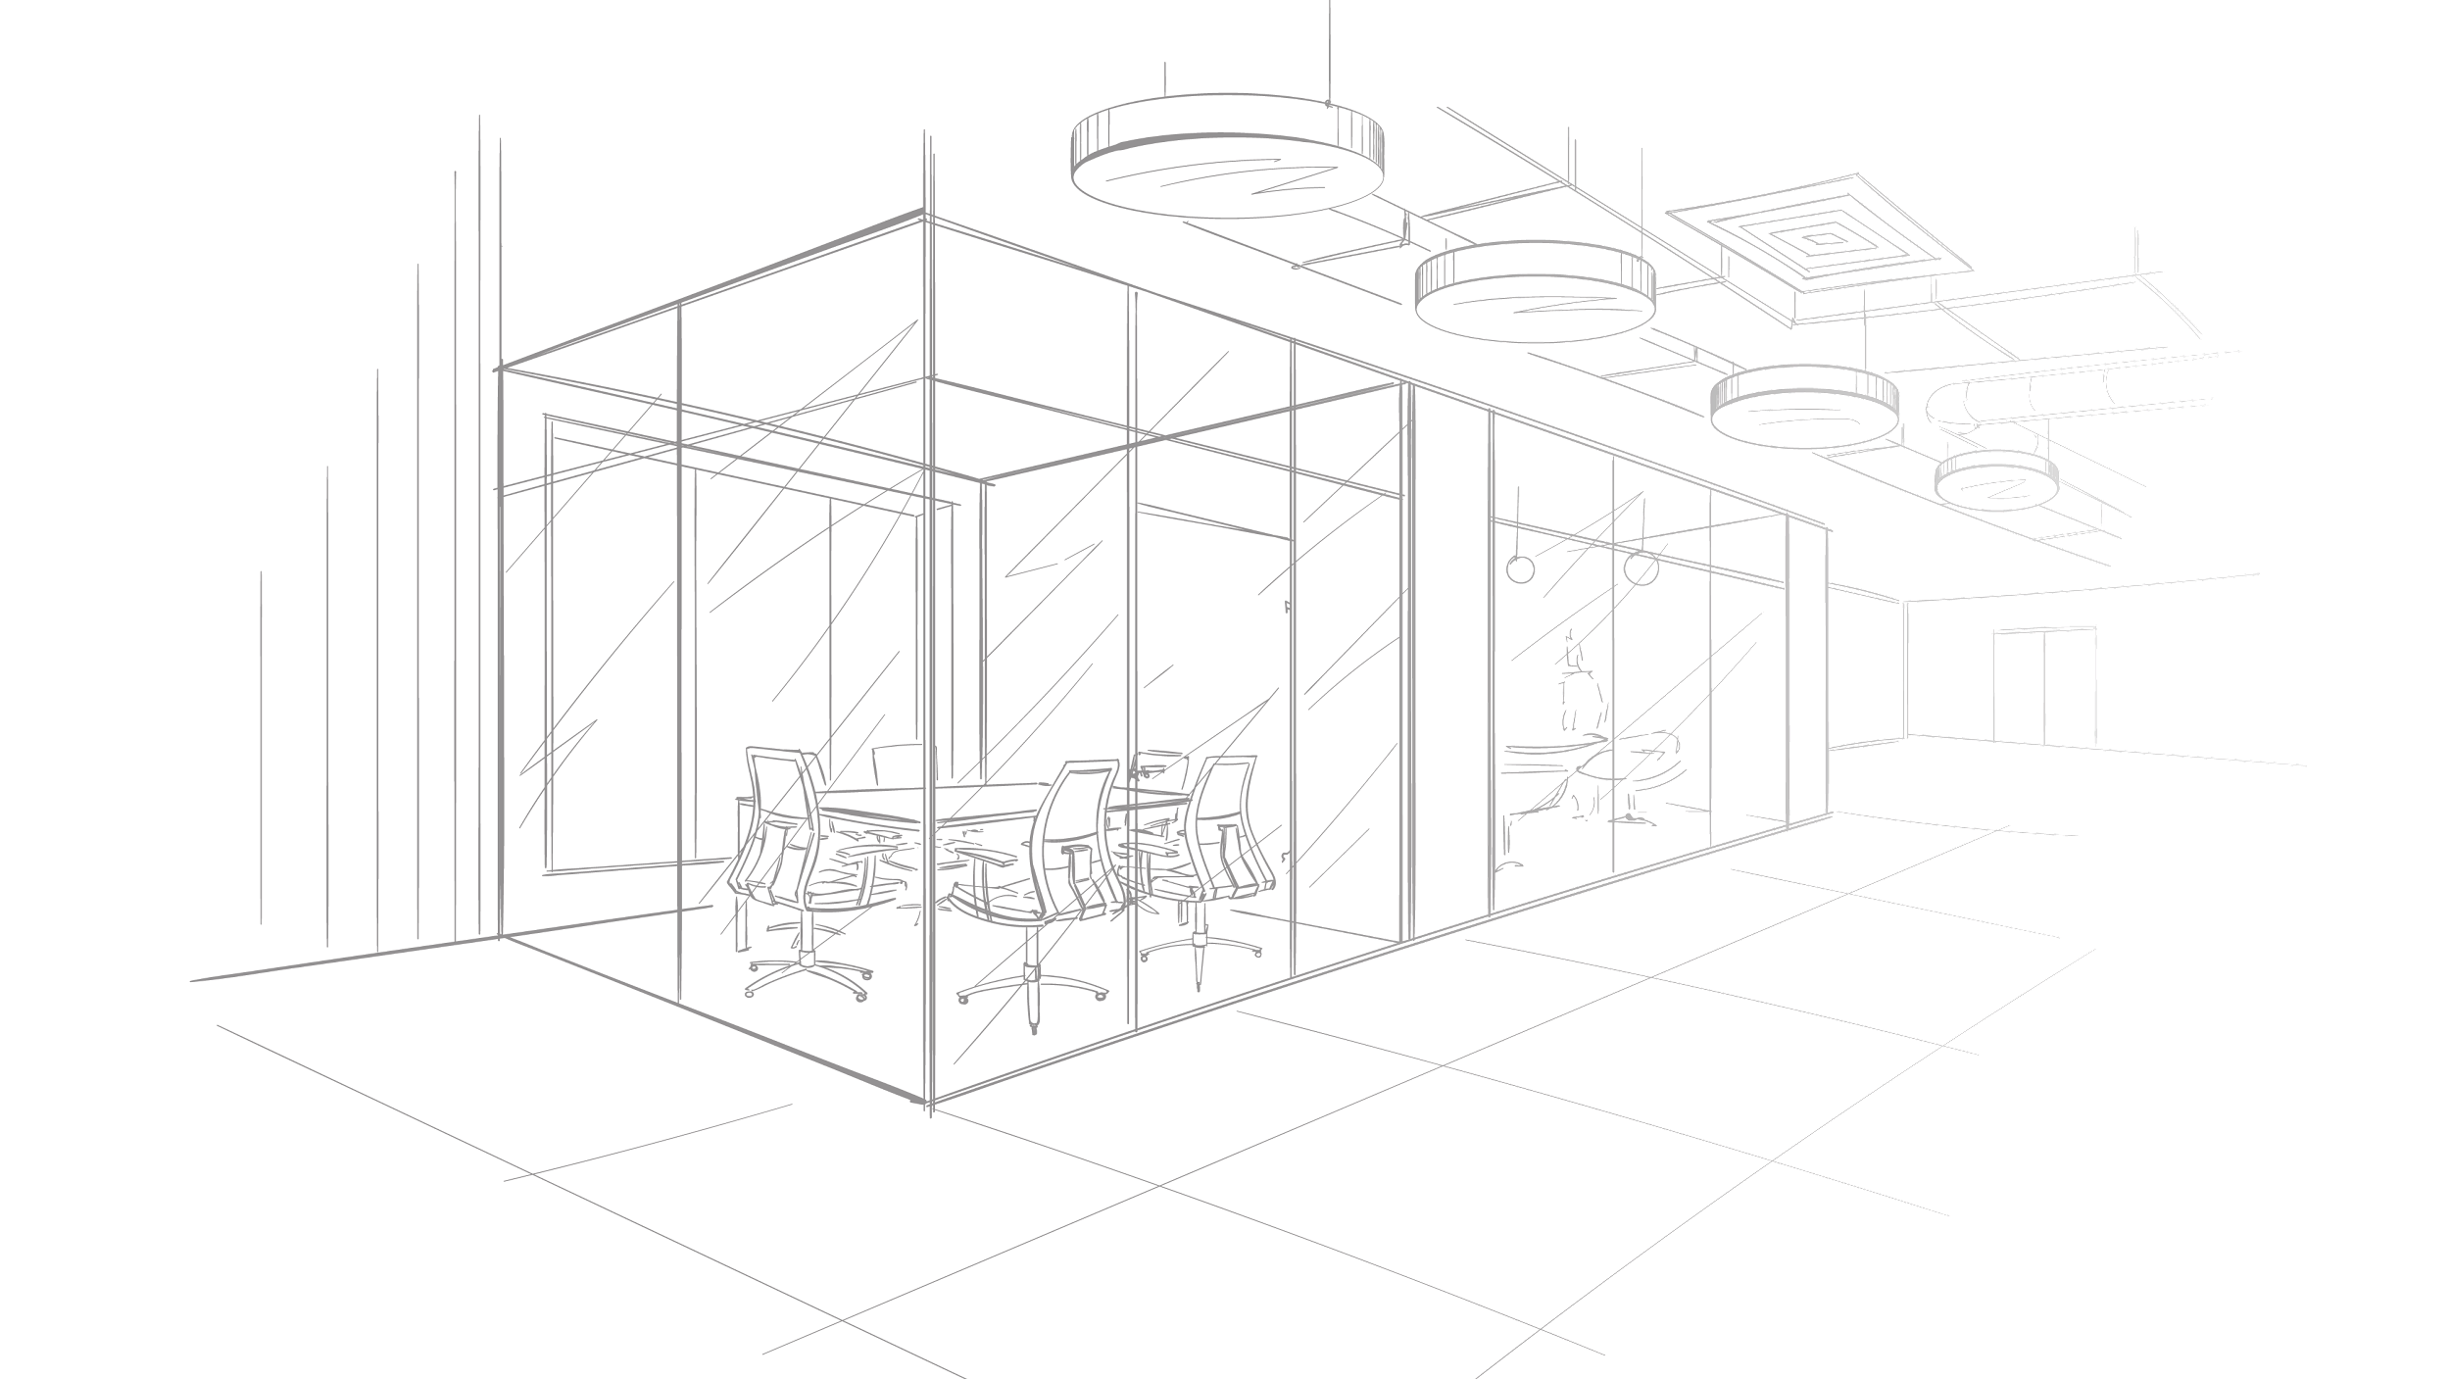
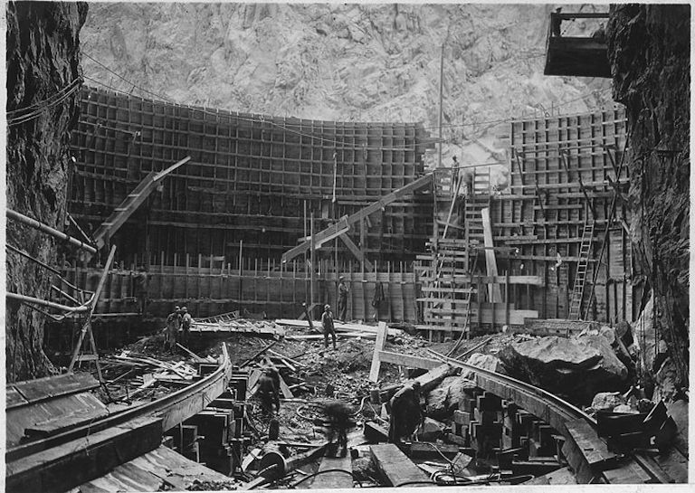

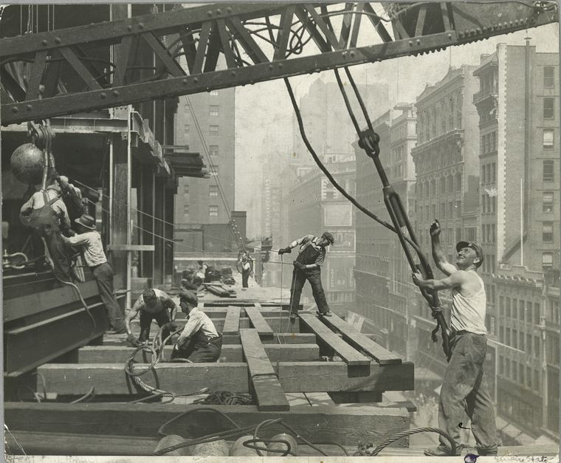

Traditional Project Management

Slide 4
Waterfall
Requirements
Design
Implementation
Verification
Maintenance
Product Requirements Document
Software Architecture
Software
Notes:
Header text
Sub text
Block text optional

Slide 5
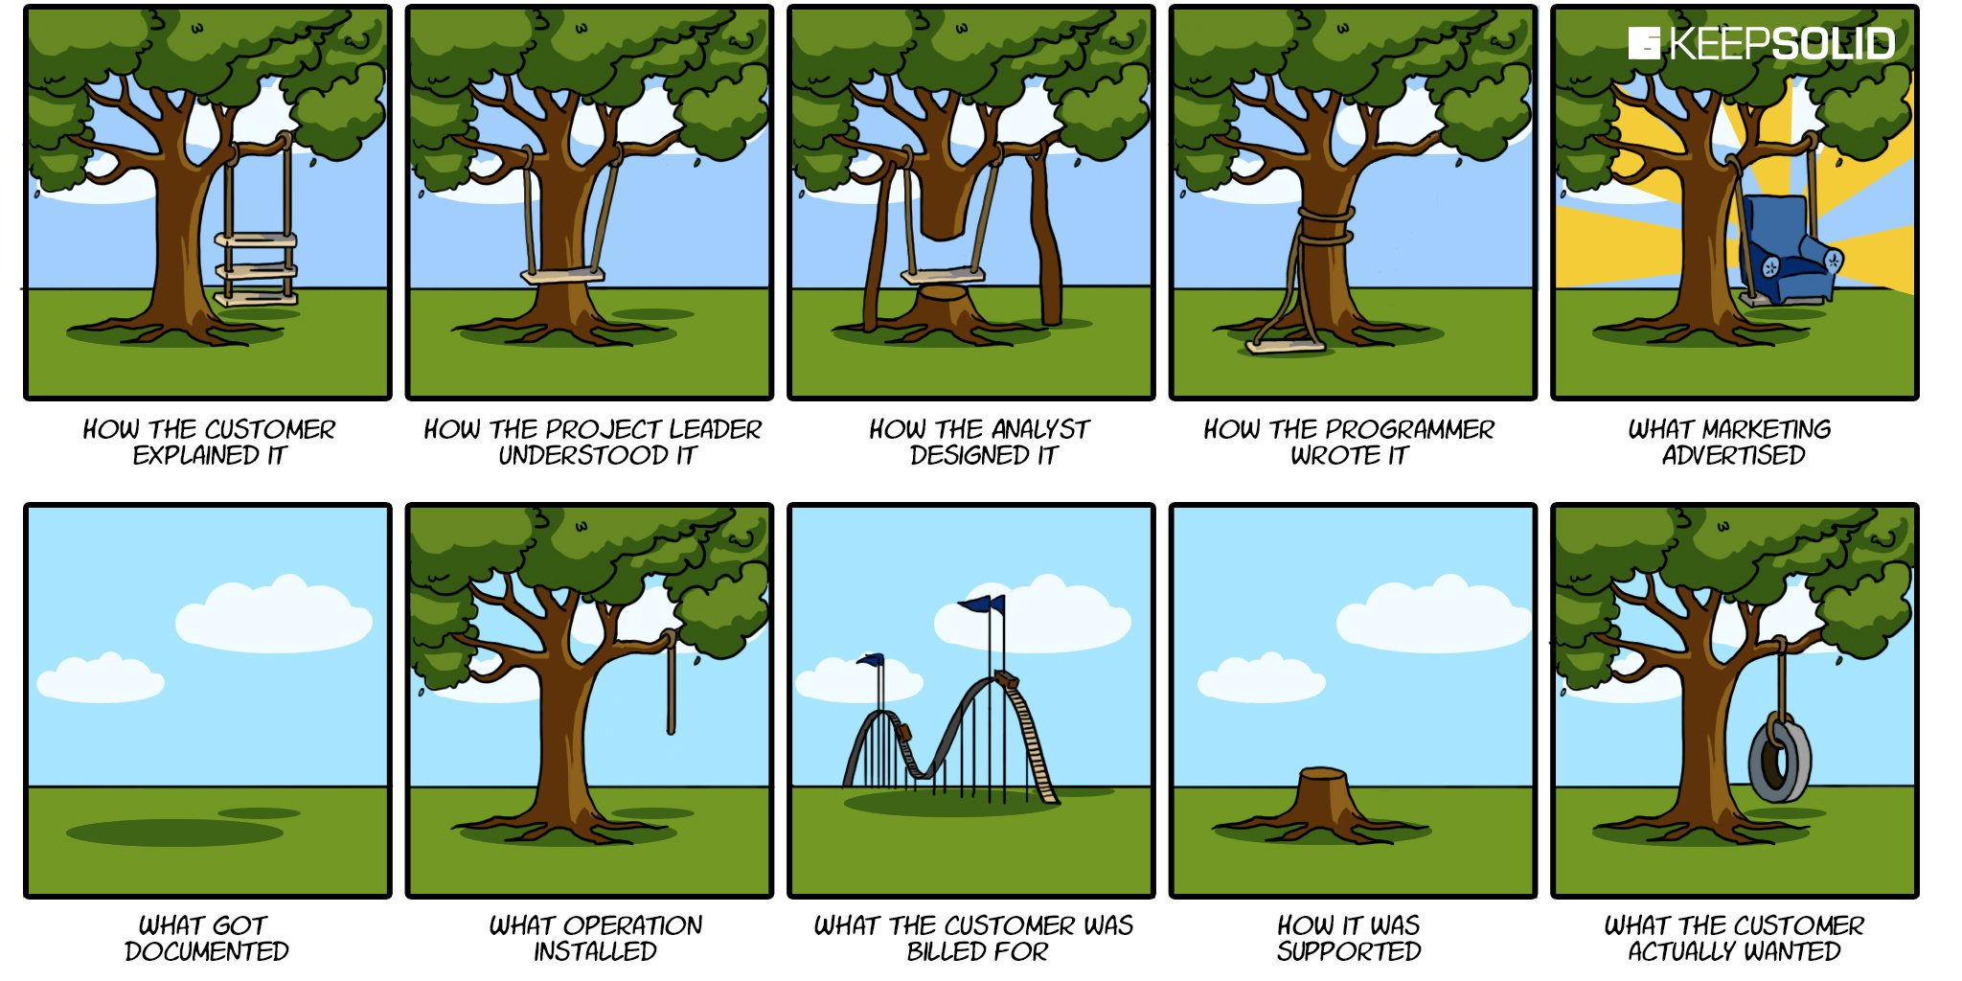
Notes:
Header text
Sub text
Block text optional

Slide 6
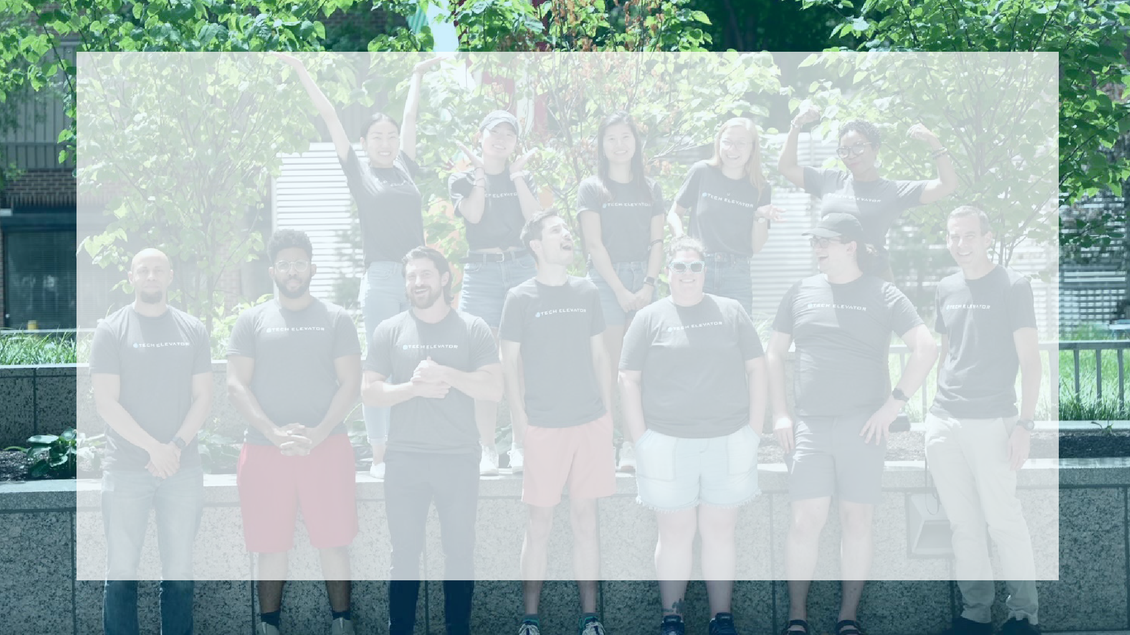
AGILE

Slide 7
MANIFESTO FOR AGILE SOFTWARE DEVELOPMENT (2001)
We are uncovering better ways of developing software by doing it and helping others do it. Through this work we have come to value:
Individuals and interactions over processes and tools
Working software over comprehensive documentation
Customer collaboration over contract negotiation
Responding to change over following a plan
That is, while there is value in the items on the right, we value the items on the left more.
Notes:
Header text
Sub text
Block text optional

Slide 8
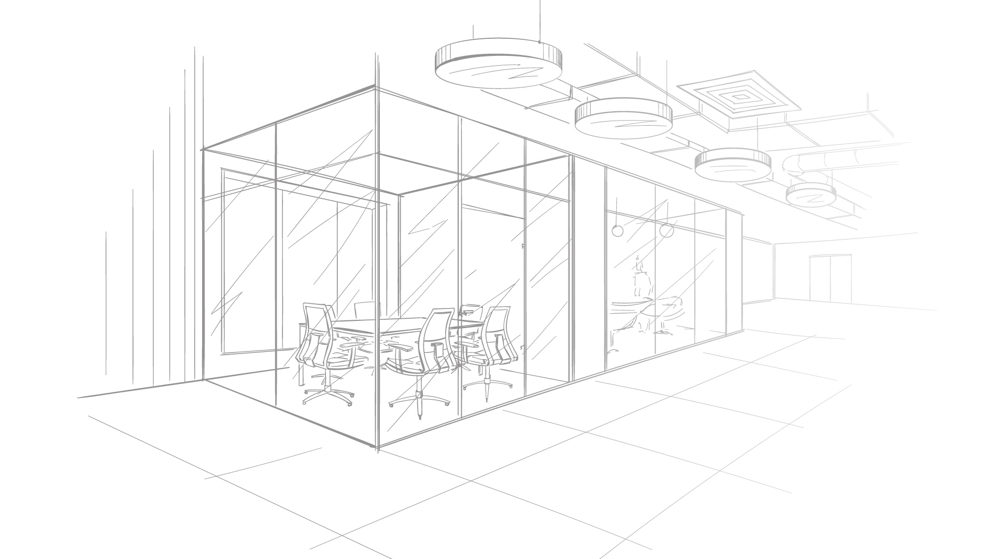
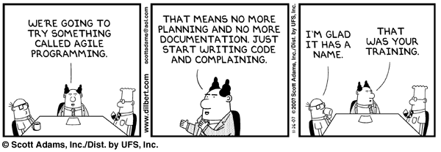

Slide 9
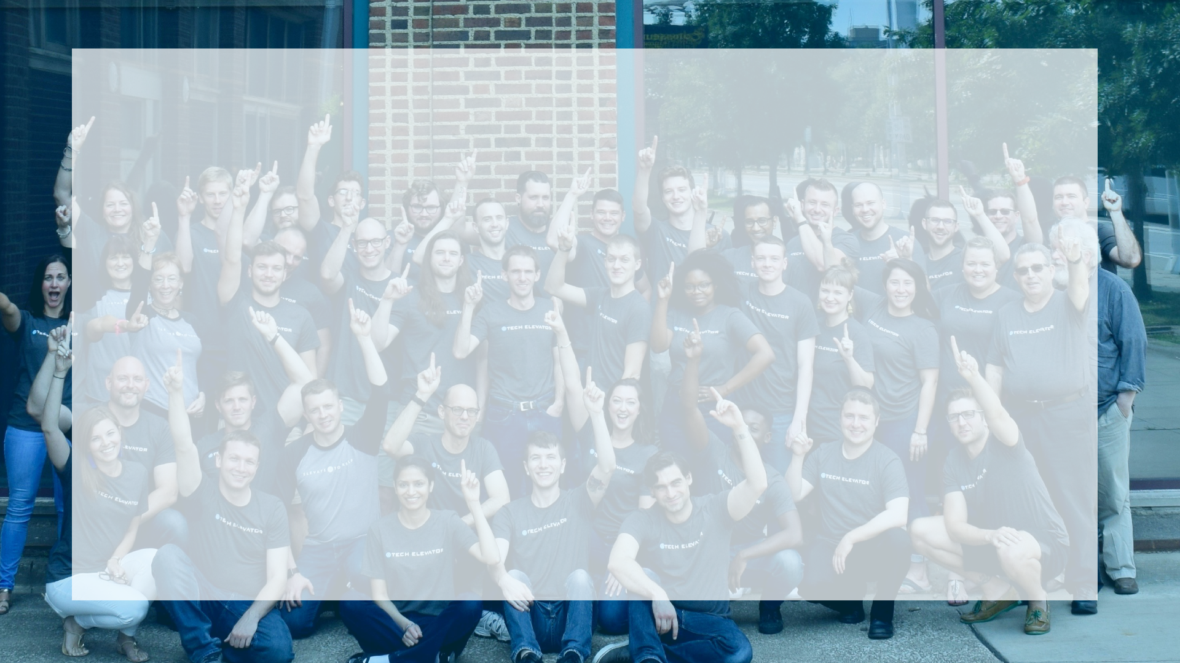
SCRUM
Notes:
Topic divider
Intro slide
End slide

Slide 10
The Scrum Team
Product Owner
The Product Owner is responsible for maximizing the value of the product and the work of the Development Team. Defines the scope of a project and sets priority.
Development Team
The Development Team consists of professionals who do the work of delivering a potentially releasable increment of “Done” product at the end of each Sprint. Cross-functional team of Business Analysts, Developers, QA, etc.
Scrum Master
The Scrum Master is responsible for ensuring Scrum is understood and enacted. Scrum Masters do this by ensuring that the Scrum Team adheres to Scrum theory, practices, and rules.
Notes:
Header text
Sub text
Block text optional

Slide 11
The Scrum Events
The Sprint
A time-box of one month or less during which a “Done”, useable, and potentially releasable product Increment is created. A new Sprint starts immediately after the conclusion of the previous Sprint.
Sprint Planning
The work to be performed in the Sprint is planned at the Sprint Planning. This plan is created by the collaborative work of the entire Scrum Team.
Daily Scrum (Stand-Up)
The Daily Scrum is a 15-minute time-boxed event for the Development Team to synchronize activities and create a plan for the next 24 hours.
Sprint Review (Demo)
A Sprint Review is held at the end of the Sprint to inspect the Increment and adapt the Product Backlog if needed.
Sprint Retrospective
The Sprint Retrospective is an opportunity for the Scrum Team to inspect itself and create a plan for improvements to be enacted during the next Sprint.
Notes:
Header text
Sub text
Block text optional

Slide 12
Scrum Artifacts
Product Backlog
The Product Backlog is an ordered list of everything that might be needed in the product and is the single source of requirements for any changes to be made to the product. The Product Owner is responsible for the Product Backlog, including its content, availability, and ordering.
Sprint Backlog
The Sprint Backlog is the set of Product Backlog items selected for the Sprint, plus a plan for delivering the product Increment and realizing the Sprint Goal. The Sprint Backlog is a forecast by the Development Team about what functionality will be in the next Increment and the work needed to deliver that functionality into a “Done” Increment.
Notes:
Header text
Sub text
Block text optional

Slide 13

User Stories
Requirements are given in the form of user stories. User stories shift the focus of the application toward the user instead of the technology.
As a <type of user>, I want <to do something> so that <some reason>.
User stories aren’t necessarily individual tasks and may need to be broken down further.

Slide 14

CAPSTONES
Notes:
Topic divider
Intro slide
End slide

Slide 15

Teams
3-5 students per team
Your instructor will be the project’s Scrum Master
Attends daily stand-up
Attends Sprint Retrospective
Your instructor/Tech Elevator staff will be the Product Owner
Attends Sprint Review/Demo
Available for questions via Slack or email

Slide 16

Events
10-business-day project, 3 sprints:
Sprint 1 review/retro Wednesday morning (week 1)
Sprint 2 review/retro Monday morning (week 2)
Sprint 3 review/retro Wednesday afternoon (week 2)
Demo Day Friday (week 2)
Morning - 10 minute demos for peers, instructors, staff
Afternoon - Science fair-style presentations for guests

Slide 17
Calendar
Week 1
MONDAY | Sprint 1, Day 1
TUESDAY | Sprint 1, Day 2
WEDNESDAY | Sprint 1, Day 3 | DEMO #1
THURSDAY | Sprint 2, Day 1
FRIDAY | Sprint 2, Day 2
Week 2
MONDAY | Sprint 2, Day 3 | DEMO #2
TUESDAY | Sprint 3, Day 1
WEDNESDAY | Sprint 3, Day 2 | DEMO #3
THURSDAY | Cleanup Day
FRIDAY | Graduation | FINAL DEMO
Notes:
Header text
Sub text
Block text optional

Slide 18
Each Team Receives
Starter code to clone from GitLab
Trello board to manage project:
Product Backlog - list of tasks that need to performed; Product Owner will prioritize and move to Sprint Backlog
Sprint Backlog - tasks that need to get done in the current Sprint; Content is done in collaboration with Product Owner
In Progress - tasks that are currently being worked on; Team moves cards here from Sprint Backlog
Ready for Review - tasks completed and ready to demo to Product Owner; If demo is not accepted by Product Owner, task is moved back to Sprint Backlog
Done - tasks that have been completed and accepted by Product Owner
Cards are marked MVP (Minimum Viable Product), Notes, and Optional
MVP cards should be completed first
Product Owners may add, change, re-categorize, or re-prioritize cards at will
Slack channel for each project for Team, Product Owner, and Scrum Master communications
Notes:
Header text
Sub text
Block text optional

Slide 19

Communication and Professionalism
Working hours are 9 AM to 5 PM
Work with your Scrum Master and team if an alternative schedule is required for you to contribute.
Be responsive
Participate in all meetings
Act professional for all Scrum meetings
Work for the good of the group
Notes:
Bullets

Slide 20
Final Advice
Make a plan
Draw a design together, use the diagrams we’ve used in class
Limit work in progress
The whole team should be working on same story
Stay focused on getting the “happy path” fully implemented
Communicate, communicate, communicate!
Work together
Don’t spin your wheels too long, reach out to teammates for help
Let your team know when you’re going to be unavailable
Commit early, commit often
Be demo-ready
Notes:
Header text
Sub text
Block text optional

